Slide 1
Rare Pattern Mining through Rare Pattern Growth
Ian Smith

Slide 2
Introduction

Slide 3
What is Rare Pattern Mining
Rare Pattern Mining is the extraction of items and sets within a database which almost never occur

Slide 4
Technologies
Software written in C++
Compiled in G++
Transaction databases represented by .txt

Slide 5
Description

Slide 6
Transaction Phase
Reads the database
Creates a list of Transaction objects
Adds the Transactions to a list

Slide 7
Pruning Phase
Creates a table of all items in all transactions
Removes non-rare items
Sorts the table
Removes non-rare items from transactions
Removes empty transactions
Sorts transactions
Sorts transaction list

Slide 8
Construction Phase
Adds each transaction to the Rare Pattern Tree

Slide 9
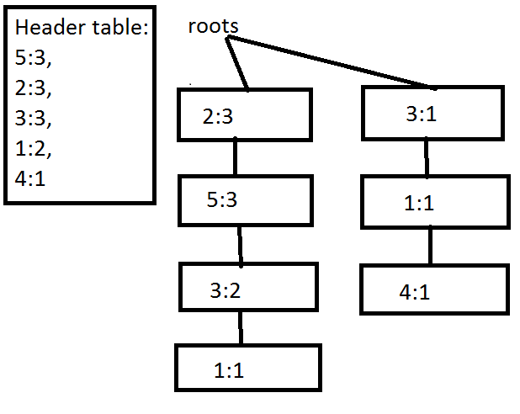

Slide 10
Mining Phase
Recursively mines the RPTree for rare item sets

Slide 11
PreciseDB Sets
Input file: Input/PreciseDB.txt
There are 19 patterns in this database with a support of 3 or less
{{2}: 3,
{3}: 3,
{5}: 3,
{1}: 2,
{1,5}: 1,
{5,3}: 2,
{1,3}: 2,
{1,5,3}: 1,
{3,2}: 2,
{5,2}: 3,
{1,2}: 1,
{1,5,2}: 1,
{5,3,2}: 2,
{1,3,2}: 1,
{1,5,3,2}: 1,
{4}: 1,
{4,3}: 1,
{4,1}: 1,
{4,3,1}: 1}

Slide 12
Analysis

Slide 13
Success?

Slide 14
Efficiency

